Slide 1
Good practices from CEI countries for achieving low carbon targets in the society
Round Table
“After Paris Agreement”
Kenty Richardson, Director for International Relations,
REC Head Office
&
Katarina Georgievska
REC, Macedonia Country Director

Slide 2
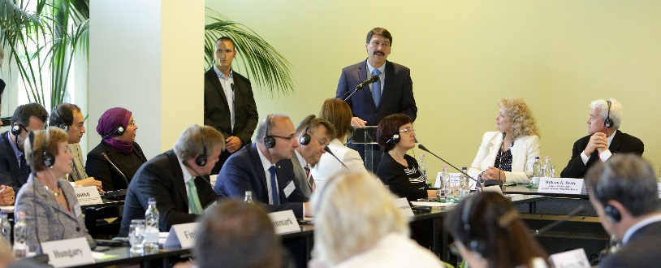
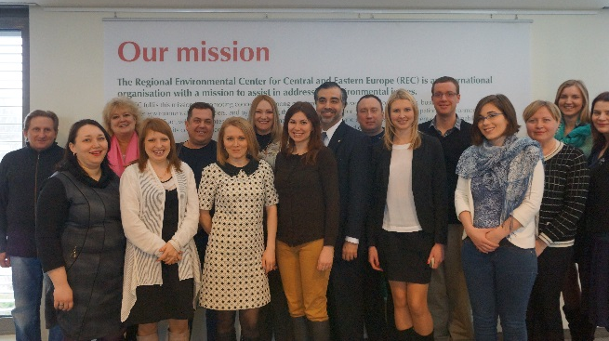
About the Regional Environmental Center
The REC was established in 1990 by USA, Hungary and the European Commission to enhance cooperation among the key stakeholders and address environmental issues in the region
The REC has 25 years of experience in supporting the stakeholders in CEE in:
transition to democracy and market economy;
EU enlargement process;
moving towards sustainable development and green growth
The REC has implemented over 2.000 projects with total budget of over 200 MEUR through multi-stakeholder partnerships

Slide 3
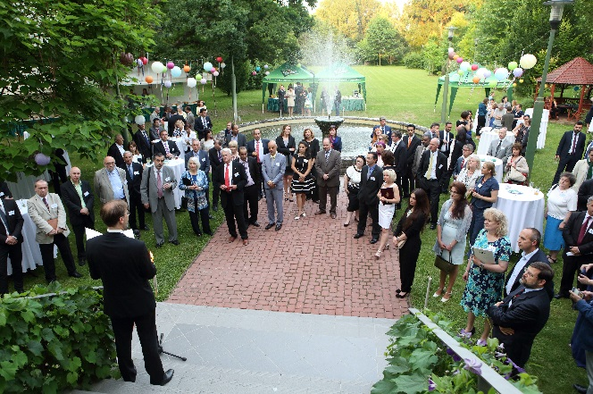
The REC today…
is an international organisation with head office located in Szentendre, Hungary;
is legally based on a charter signed by 32 countries and the European Commission;
has a Board of Directors with international members;
has a regional presence and offices in CEE with an international staff of approx. 160 employees;
runs projects in EU Member States (in CEE and EU-28); EU Enlargement Countries; Eastern Partnership Countries; and beyond.

Slide 4
Strategy of the REC for 2016-2020
In its work, the REC focuses on achieving the following results:
with relevant stakeholders in its partner countries and regions
Strengthened environmental governance
Strengthened low-emission
development
Improved
natural resources management

Slide 5
Declaration on the Occasion of the 25th Anniversary of the REC
Renewed mandates for the work of the REC:
SEE 2020 Strategy
Eastern Partnership
EU Policies
Circular and Low-Carbon Economy
Post-2015 Development Agenda

Slide 6
Sustainable development challenges:
Political will
Capacities and institutions
Putting forward appropriate governance mechanisms and incentives
Coupling commitments with tools to reach objectives
Intra-governmental coordination within the administrations
Low awareness of the society in SEE countries
Practical & technical knowledge for implementation in SEE countries
Notes:
Coalition agreement:
Aid for trade increased importance
6

Slide 7
REC as an agent for the transfer of knowledge
to countries and regions

Slide 8
Climate Change and Clean Energy
Promotion of Low-Carbon Society
SLED (Supporting Low Emission Development in South East Europe)
Modelling decarbonisation pathways for the electricity and residential building sector
Local Governments Action
Networking action for mobilising local governments in the EU to take active part in international climate and energy debate
Financing Low-Carbon refurbishment
Demonstration project in the CEE region for improving conditions for financing low-carbon refurbishment projects
Regions for Sustainable Change
REC is the lead partner in a 12-member partnership incorporating climate change into the economic and regional development plans of 12 EU regions
Promotion of Sustainable Energies
INTENSE
transferring of intelligent energy-saving measures from municipal housing in old EU member countries (Germany) to new members and candidate countries
EU-China Clean Energy Center project
Facilitating cooperation between China and the EU in the field of clean, sustainable energy and GHG emission mitigation through the Center set in Beijing

Slide 9
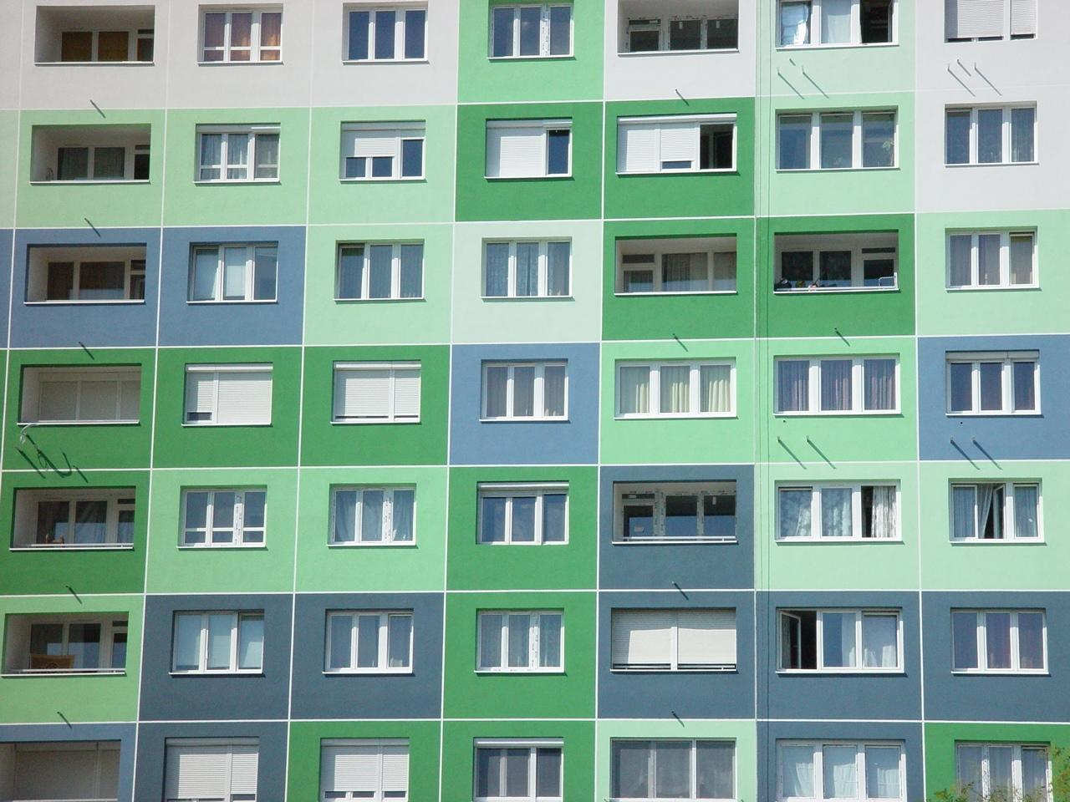
Supporting Low-emission Development
in South Eastern Europe (SLED)
REC’s project with 1.25 MEUR funding from the Austrian Development Cooperation for 2013-2015;
Assessing and identifying options for low-emission development in electricity generation and energy efficiency of residential buildings in South Eastern Europe;
In focus: Albania, FYR Macedonia, Kosovo*, Montenegro and Serbia
Modelled decarbonisation pathways and associated costs/benefits for Albania, Montenegro, Serbia and FYROM for electricity and residential sector (2030 time horizon)
Draft modelling results were already used for the INDC of Montenegro and Albania
Final results will be presented at the Paris COP (EU Pavillion)
Notes:
Through the modelling of electricity and energy efficiency pathways and costs, as well as emissions reduction options, the project provides a basis for the informed preparation of low-emission development strategies. The time horizon for the modelling-based scenarios at country/sector level is 2025/2030, and the studies will also identify potential nationally appropriate mitigation actions.
Government representatives, stakeholders and experts will be involved in the development of the scenarios, and the results of the work will be published in national languages as well as English. The results will also be introduced at workshops in the target countries and to the donor community.
The SLED project is divided into two components. The larger component is implemented by the REC in Albania, the former Yugoslav Republic of Macedonia, Montenegro and Serbia, while Component 2 will be implemented by UNDP Kosovo as a local partner in Kosovo*. Both project components support low-emission development.

Slide 10
Regions for Sustainable Change: Showing the way to a low-carbon future for European regions
A partnership of 12 organisations from eight EU member states. Through regional cooperation, the project aims at promoting an EU-wide shift to climate-friendly economies and seeks to identify opportunities for, and the costs and effects of, moving to a low-carbon economy.
The focus of the project is to provide regions with the methodological means to move towards economies with minimal GHG emissions by integrating all aspects of the economy around technologies and practices with low emissions.
Key to success: the partners are willing to learn from one another, to exchange experiences, and to share the results of their efforts during the three-year project.

Slide 11
In own ‘mini-projects’ municipalities develop energy strategies, public awareness raising plans or apply technical measures and altogether show different facettes of energy sound urban planning in practice.

Slide 12
ORIENTGATE – Example: Urban health
REC was leading a Thematic Center on Urban Adaptation and Public Health – case studies:
Vulnerability assessment of crucial urban systems with special emphasis on public health against the heat waves
Evaluation of adaptive capacities and climate resilience of hospitals, kinder gardens, and senior citizens’ houses
Cooperation with lead science institute on future climate scenarios covering the Carpathian Basin with 10–25 km horizontal resolution
Intense public participation through stakeholder consultations and awareness raising
Desk research and literature review on the topic, field missions for data gathering on houses, analytical processing of the collected data through modeling and qualitative analysis, stakeholder consultations, training, and awareness raising events
Notes:
Integrating climate change related knowledge into planning
Coordinate CC adaptation efforts in SEE
Building partnerships among communities
21 financing partners, 9 associates and 3 observers-covering 13 countries
Thematic centers (forestry and agriculture; drought, water and coasts, urban adaptation and health)

Slide 13
EEA Grant (2012-2016) program: Adaptation to CC
A component of the project is establishing a systematic assessment tool for supporting adaptation related decision making - National Adaptation Geographical Information System-NAGiS for Hungary
Providing detailed information with high resolution (10 km x 10 km) on key areas of weather related disaster and climate vulnerabilities
Cost effective and easily updateable system for vulnerability assessment to cover large geographical areas (current case: Hungary)
Combines databases, remote sensing and dynamic modell outputs in a meta-database visualised on maps
Notes:
The focus is on the NAGIS example. We are working on having similar systems implemented in other countries along the Danube and in SEE.

Slide 14
NAGIS: a help for sectoral and spatial planning
The NAGiS will provide information for national, regional and local administration and municipalities for the sectoral and spatial planning in the fields of
climate policy
energy policy
disaster relief
transportation and infrastructure
development policy
agriculture
rural development
forestry
settlement and regional plans
public utilities management
tourism
health, quality of life
Human health
Agriculture
Settlement planning
Transportation
Energy policy
Tourism
Disaster management
Forestry
Infrastucture
Notes:
The NAGIS type systems are good to assist planning taking into consideration vulnerabilities connected to climate change. It can also help to spot likely impacts of extreme weather events – both features are useful for

Slide 15
NAGIS – basic layers of the system transposed on each other
Digital Elevation Model
Surface waters
Geology
Climate change effects will be modelled based on input data layers
Climate projections

Slide 16
REC as an agent for the transfer of knowledge
to countries and regions

Slide 17
Thank you for your attention!

